Slide 1
Investigating Global and National Sustainable Energy Transition Paths
Dénes Csala
PhD Qualifying Exam Part 2
Masdar Institute
20 trillion green watts
and their implications on the Water-Energy-Food nexus

Slide 2
20 trillion green watts

Slide 3
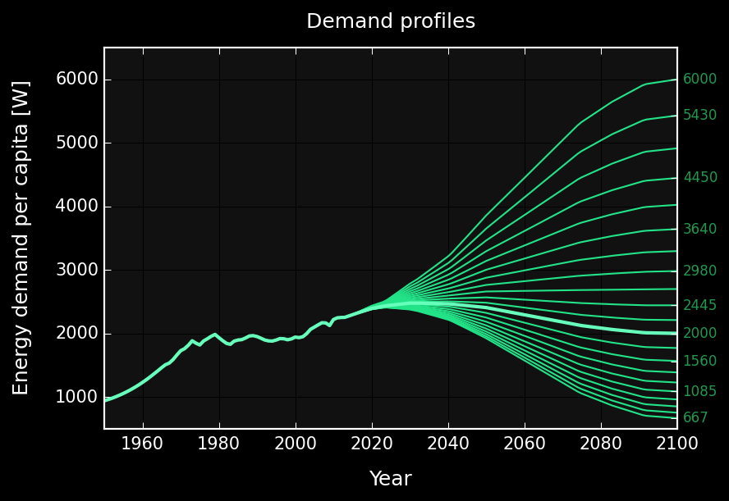
2000 W / capita ∙ 10 billion people = 20 trillion W
Pickard (2014)
Trainer (2014)
Spreng (2005)
Project Novatlantis (2004)
Marechal et al. (2005)
Jacobson , Delucchi (2011)
An average net primary power of 2000W per capita may be considered as a lower limit for maintaining an acceptable quality of life in a technical society.
Marechal et al. (2005), Pfeiffer et al. (2005),
Spreng (2005), Schultz et al. (2008), Huebner (2009)
GRAPH: Own work based on open energy data from EIA (1970-2040), BP (1960-2035), population data from UNSD, (1950-2100)

Slide 4
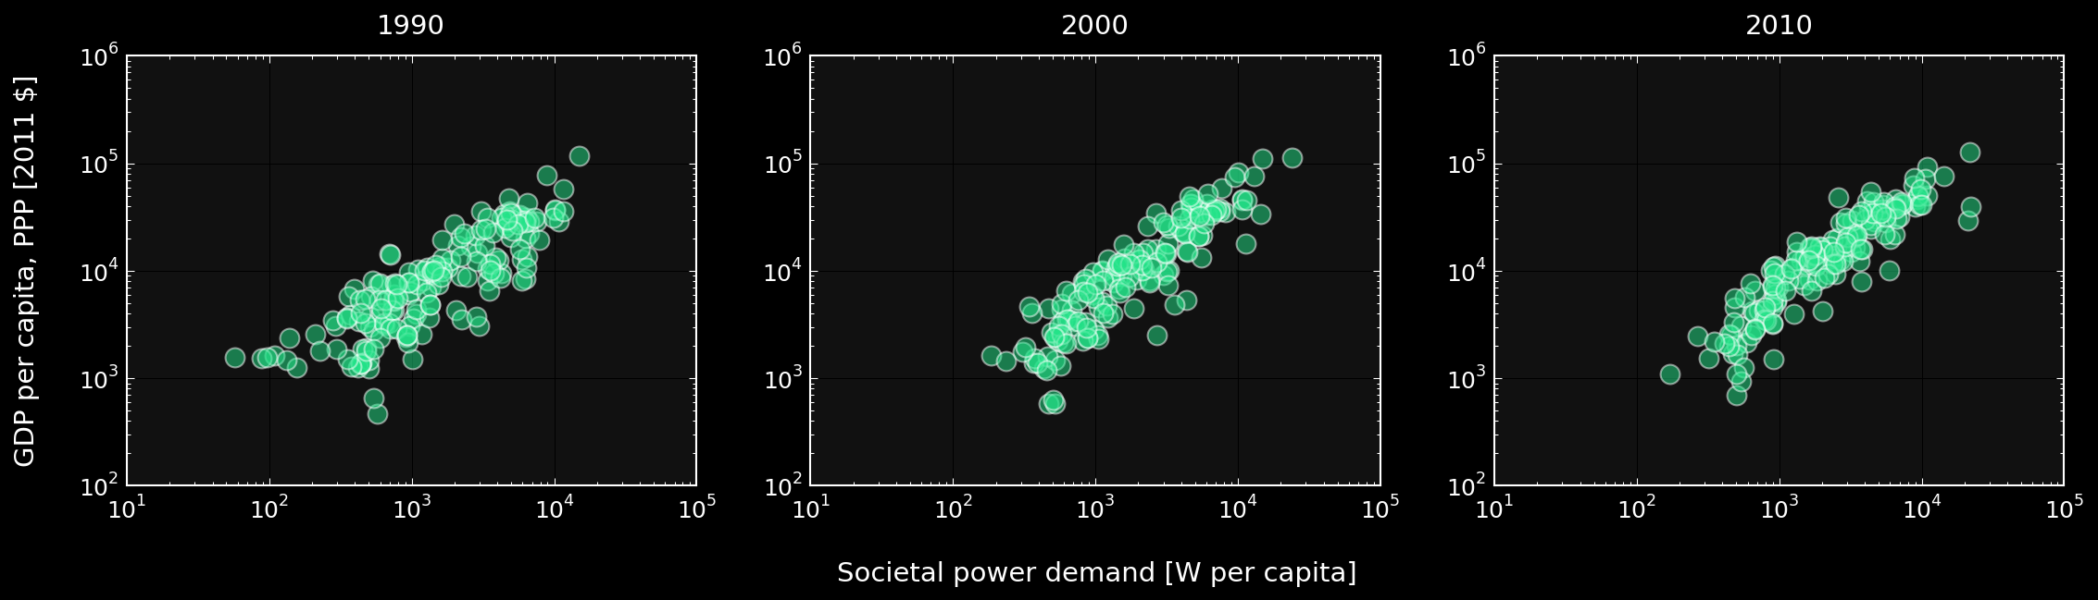
“Massive reductions in OECD countries would perhaps even leave room in the global CO₂-emission budget to allow poverty eradication as stipulated in the UN millennium goals without triggering catastrophic climate change.”
Spreng (2005)
GRAPH: Own work based on open energy and GDP data from World Bank (1990-2010)
Notes:
Wealthy countries could afford to do that because of fossil fuels. 2 problems with that. Depletion and global warming.

Slide 5
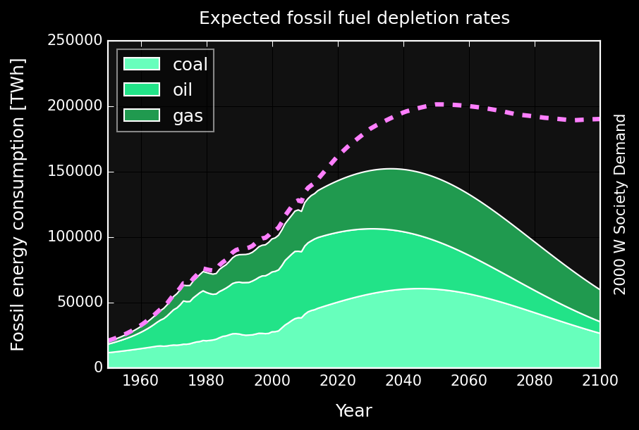
IPCC AR5 WG1 RCP2.6
Carbon budget*
990 GtCO₂
[510 – 1505]
2032
[2020-2045]
GRAPH: Own work based on open energy data from EIA (1970-2040), BP (1960-2035), population data from UNSD, (1950-2100)
Maggio, Cacciola (2012), Mohr et al. (2015)
* Fossil fuels, industrial processes (including cement) and waste
Notes:
Wealthy countries could afford to do that because of fossil fuels. 2 problems with that. Depletion and global warming.

Slide 6
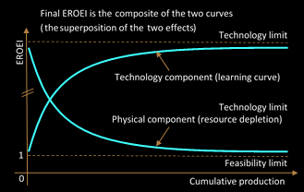
Energy Return on Energy Invested = EROEI
Solar PV 5 – 15
Wind 20 – 40
Solar CSP 10 – 20
Geothermal 15 – 35
Oil 25 – 10 [60 – 40]
Gas 25 – 15 [60 – 40]
Coal 50 – 15 [100 – 80]
Barnhart, Dale et al. (2013), Klemes (2015), Hall (2014)
King, Hall (2011), Gupta (2011), Moerschbaecher (2011), Kubiszewski (2010)
GRAPH: Own work based on Dale, Krumdieck (2012)
Notes:
Wealthy countries could afford to do that because of fossil fuels. 2 problems with that. Depletion and global warming.

Slide 7
sustainable energy transition

Slide 8
sustainable energy transition
The rate of pollution emissions is less than the ecosystem assimilative capacity.
Renewable energy generation does not exceed the long-run ecosystem carrying capacity nor irreparably compromises it.
Per capita available energy remains above the minimum level required to satisfy societal needs at any point during SET and without disruptive discontinuity in its rate of change.
The investment rate for the installation of renewable generation and consumption capital stock is sufficient to create a sustainable long-term renewable energy supply basis before the non-renewable safely recoverable resource is exhausted.
Future consumption commitment (i.e., debt issuance) is coupled to and limited by future energy availability.
Daly (1996), Sgouridis, Csala (2014)
Notes:
Wealthy countries could afford to do that because of fossil fuels. 2 problems with that. Depletion and global warming.

Slide 9
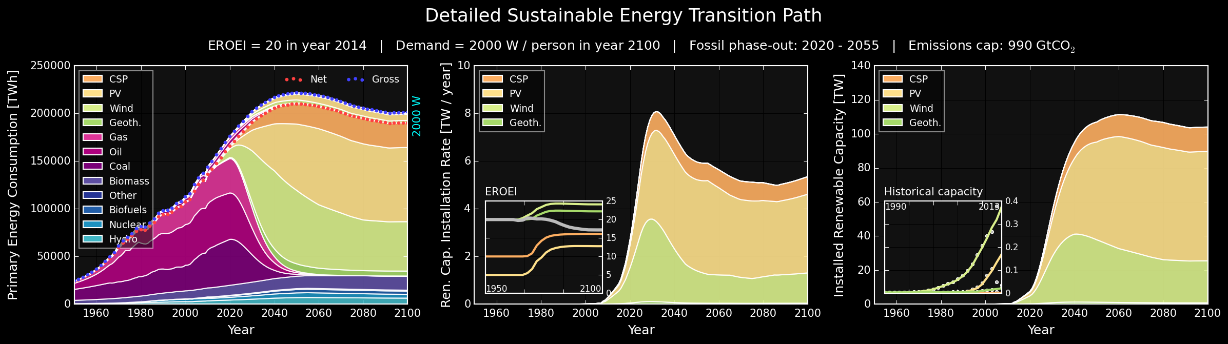
Emissions √ Carrying capacity √ Societal needs √ Investment √ Commitment √
Sgouridis, Bardi, Csala (expected 2015)
GRAPH: Own work based on the principles outlined by Sgouridis, Csala (2014) using open data from EIA, BP, UNSD
Notes:
Wealthy countries could afford to do that because of fossil fuels. 2 problems with that. Depletion and global warming.

Slide 10
research questions

Slide 11


research questions
What is the feasibility of a global sustainable energy transition?
If possible, what level of economic and social effort is necessary to achieve it?
If possible, what are its implications on the water-energy-food nexus?
What are the feasibilities of sustainable energy transitions for individual nations?
If possible how is the national sustainable energy transition affected by:
Natural resources (water, food, energy)
Economic resources and trade
If possible, what are its implications on countries’ water, energy and food policies?
completed
significant progress
Notes:
Wealthy countries could afford to do that because of fossil fuels. 2 problems with that. Depletion and global warming.

Slide 12
methodology

Slide 13
methodology
Trade
data
[UN COMTRADE]
Renewable
EROEI
[Literature]
Sustainable Energy Transition Paths
Population projections
[UNSD]
Renewable energy data
Demand data
Demand projections
[Literature]
Water-Energy-Food Nexus implications of
Sustainable Energy Transitions
Fossil
data
Food energy
flows
Emissions data
[IPCC, EIA, BP]
Food energy
data
[World Bank]
Food
data
[FAOSTAT]
Water
data
[Jesse]

Slide 14

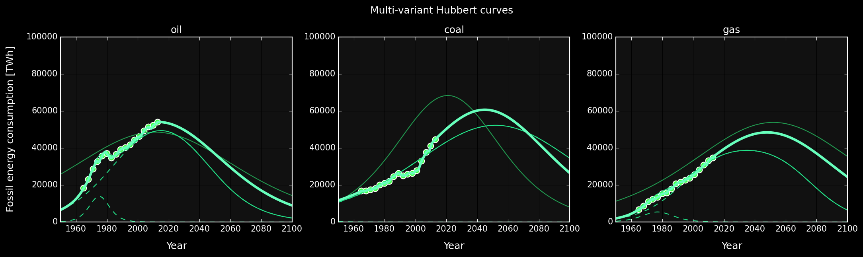


methods
$P_{M}$ - peak production, $t_{M}$ - peak year, $U$ – ultimately recoverable reserves
Forced Hubbert phase-out
Demand projections
[Literature]
Hubbert curve multi-variant
Fossil
data
Emissions data
[IPCC, EIA, BP]
$$P_{M},t_{M}$$
well-defined
U limited by carbon cap!
Maggio, Cacciola (2012)
GRAPH: Own work based on

Slide 15



methods
Renewable
EROEI
[Literature]
Population projections
[UNSD]
Renewable energy data
Demand data
Demand projections
[Literature]
Fossil
data
Emissions data
[IPCC, EIA, BP]
Own work for Sgouridis, Bardi, Csala (expected 2015)

Slide 16




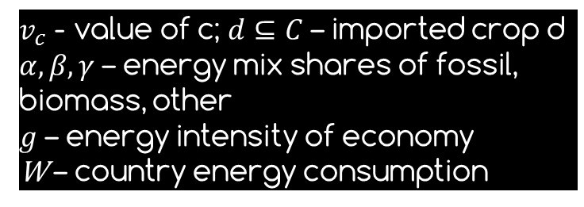



methods
Food energy
flows
Food energy
data
[World Bank]
Food
data
[FAOSTAT]

Slide 17
progress

Slide 18
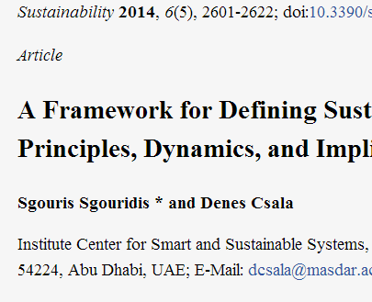
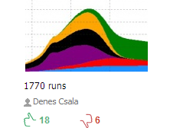
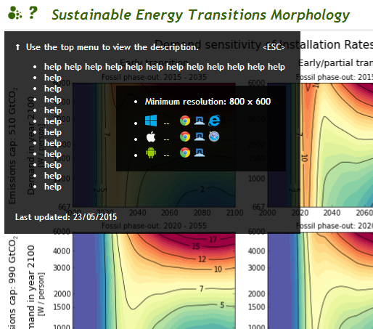
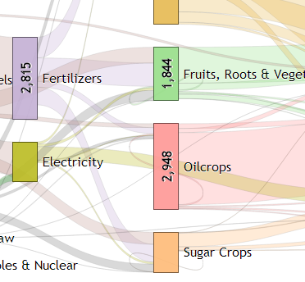
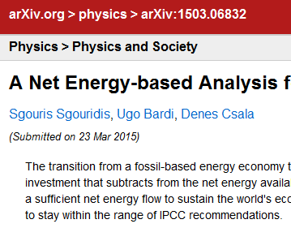
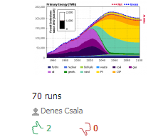
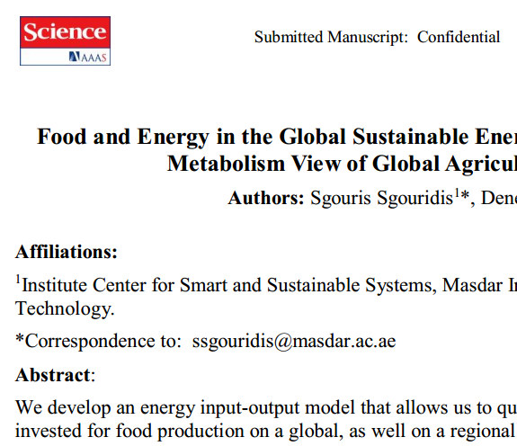
progress
most of the preparations have been done to conduct the analysis
article published
SET1.0
model published
model of
the month on runthemodel.com
in June 2014
1771 runs
website
d3.js
Data parsers written in Python + pandas for APIs:
FAOSTAT
World Bank WDI
UN COMTRADE
UNFCCC
EIA
BP
Models written in AnyLogic + JAVA:
SET1.0
SET2.0
9000 lines
16500 lines
31000 lines
website
d3.js
article
finished
SET2.0
model published
article
almost
finished

Slide 19
Emissions √ Carrying capacity √ Societal needs √ Investment √ Commitment √
Sgouridis, Bardi, Csala (expected 2015)
GRAPH: Own work based on the principles outlined by Sgouridis, Csala (2014) using open data from EIA, BP, UNSD
Notes:
Wealthy countries could afford to do that because of fossil fuels. 2 problems with that. Depletion and global warming.

Slide 20
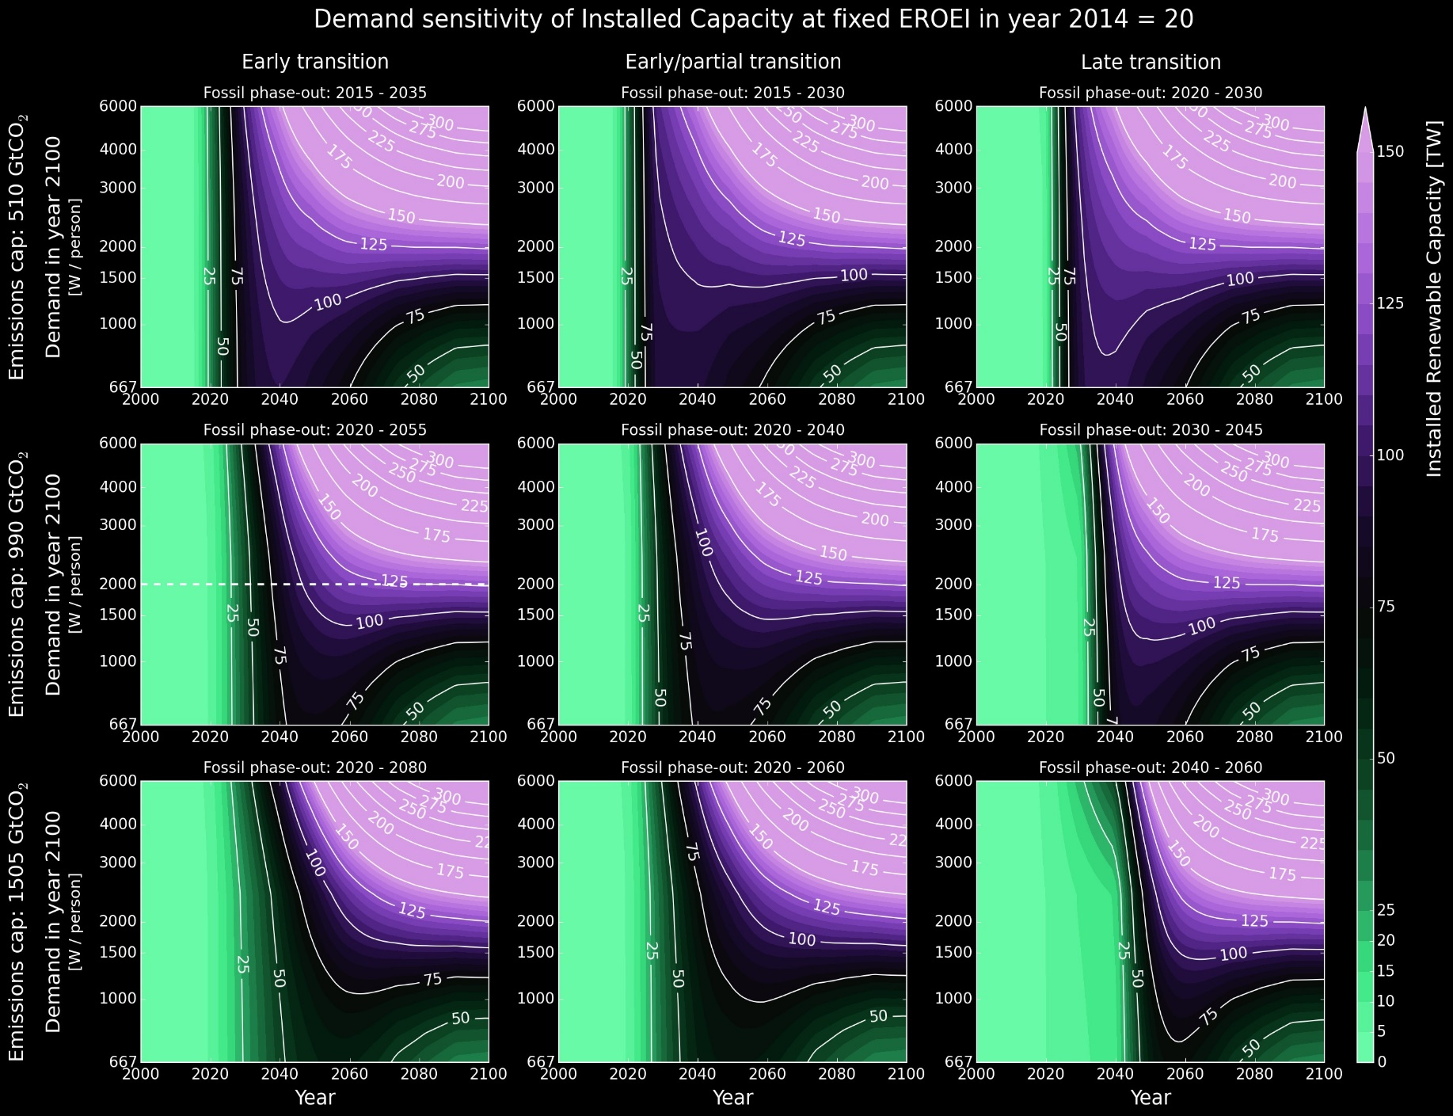
majority of additional capacity needs to be added before 2040
this holds even with very small final demand
transition speed critical
Sgouridis, Bardi, Csala (expected 2015)
GRAPH: Own work based on the principles outlined by Sgouridis, Csala (2014) using open data from EIA, BP, UNSD
Notes:
Wealthy countries could afford to do that because of fossil fuels. 2 problems with that. Depletion and global warming.

Slide 21
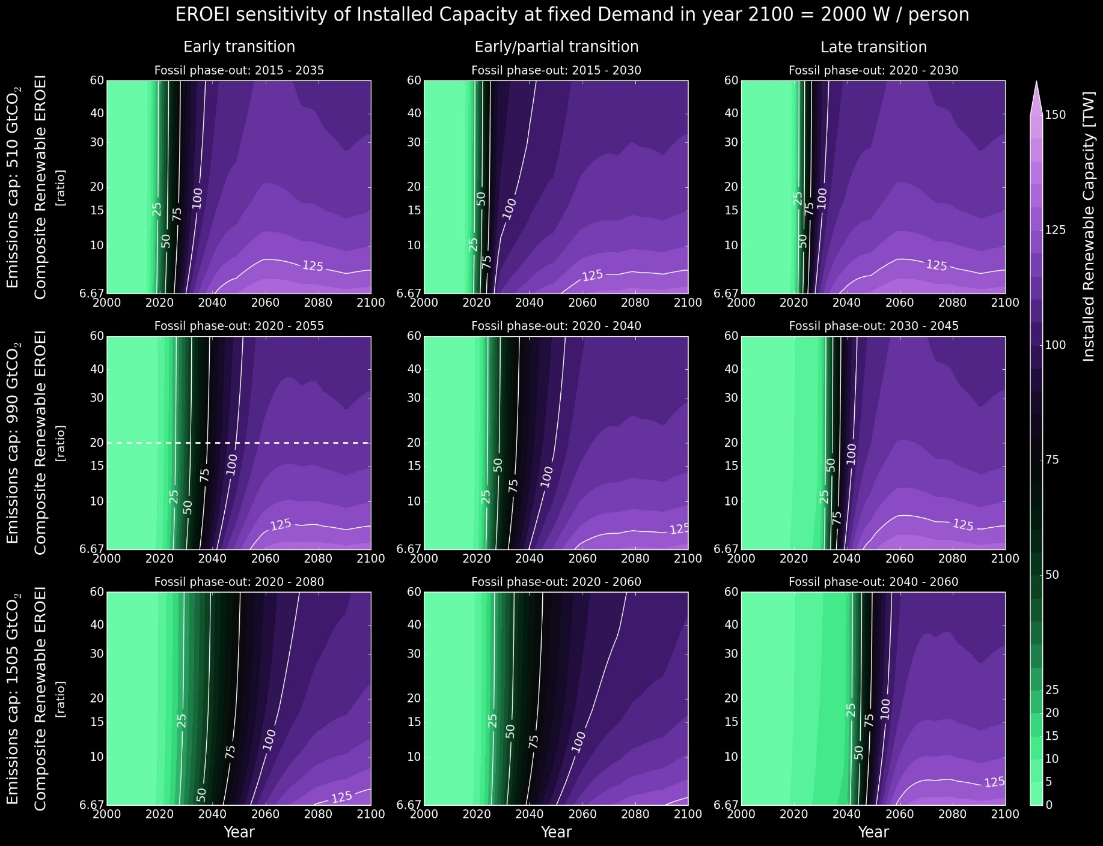
surprisingly small sensitivity to EROEI
EROEI only becomes prohibitive if very low
Sgouridis, Bardi, Csala (expected 2015)
GRAPH: Own work based on the principles outlined by Sgouridis, Csala (2014) using open data from EIA, BP, UNSD
Notes:
Wealthy countries could afford to do that because of fossil fuels. 2 problems with that. Depletion and global warming.

Slide 22
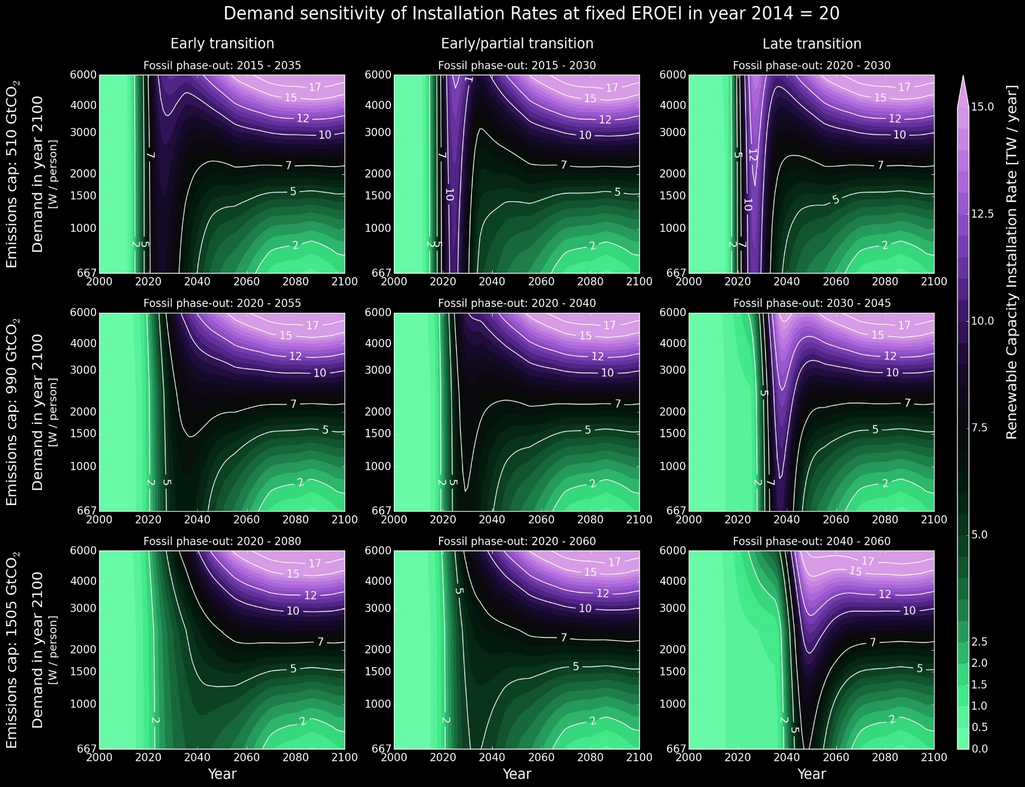
transition speed and early action is critical
if on lower margin of carbon cap, transition de facto impossible
equilibrium rate an order of magnitude higher than today
Sgouridis, Bardi, Csala (expected 2015)
GRAPH: Own work based on the principles outlined by Sgouridis, Csala (2014) using open data from EIA, BP, UNSD
Notes:
installed renewabl e now 1-2 TW – would mean nearly doubling installed capacity every year for a decade

Slide 23
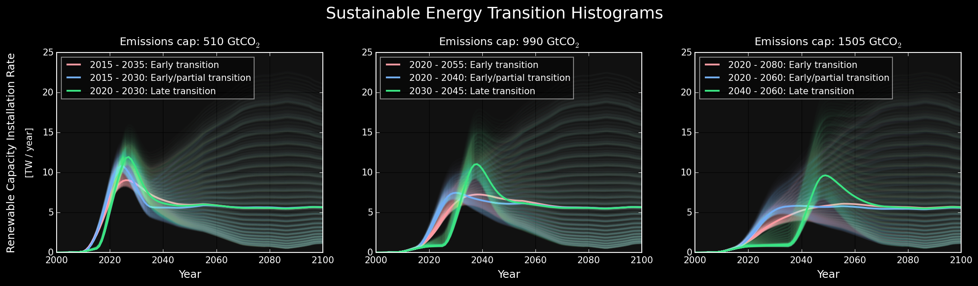
Sgouridis, Bardi, Csala (expected 2015)
GRAPH: Own work based on the principles outlined by Sgouridis, Csala (2014) using open data from EIA, BP, UNSD
Notes:
Wealthy countries could afford to do that because of fossil fuels. 2 problems with that. Depletion and global warming.

Slide 24
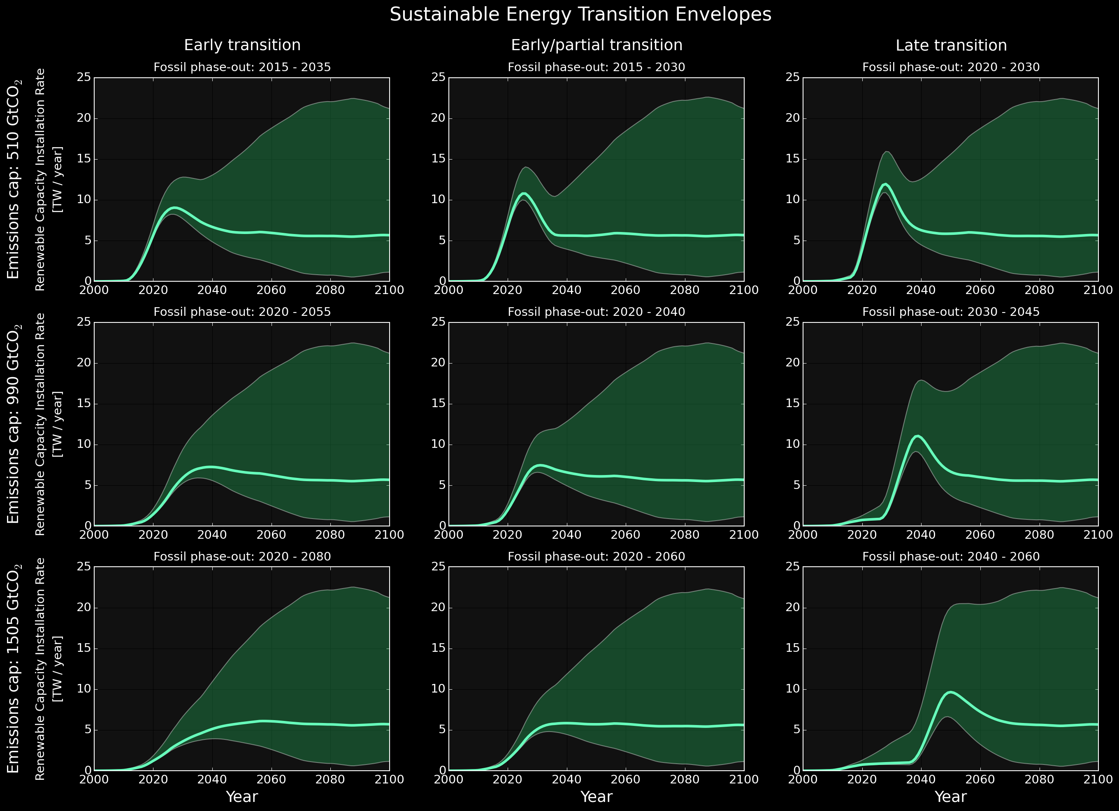
the envelopes are narrow during the early transition phase
very high energy investment increase into renewables needed, sooner than later
Sgouridis, Bardi, Csala (expected 2015)
GRAPH: Own work based on the principles outlined by Sgouridis, Csala (2014) using open data from EIA, BP, UNSD
Notes:
Wealthy countries could afford to do that because of fossil fuels. 2 problems with that. Depletion and global warming.

Slide 25

water-energy-food nexus
“Multiple intersecting factors place pressure on planetary systems on which society and ecosystems depend. Climate change and variability, resource use patterns, globalization viewed in terms of economic enterprise and environmental change, poverty and inequitable access to social services, as well as the international development enterprise itself, have led to a rethinking of development that solely addresses economic growth. Fulﬁlling the essential human aspirations for quality of life, meaningful education, productive and rewarding work, harmonious relations, and sustainable natural resource use requires ingenuity, foresight and adaptability. Societal and environmental conditions are changing rapidly in ways that increase uncertainty for decision-making over a range of scales. The intimate links between social and ecological processes are strengthened (made more fundamental than
perhaps previously believed) in the age of profound human manipulation of planetary processes characterized as the Anthropocene.” Scott (University of Arizona,) Kurian (UNU FLORES), Wescoat (MIT)
Scott, Kurian, Wescoat (2015)
Notes:
Wealthy countries could afford to do that because of fossil fuels. 2 problems with that. Depletion and global warming.

Slide 26
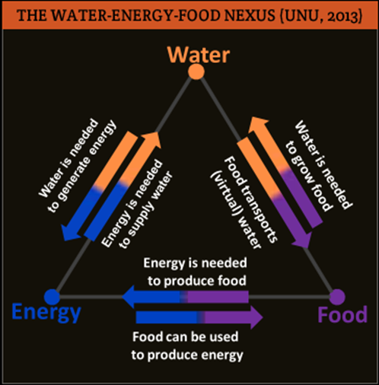
water-energy-food nexus
Renewable energy, coupled with sustainable investment, is the only enabler for keeping the water-energy-food nexus in balance (IRENA, 2015)
Total Food System Energy Input in 2011: 6929 TWh
Total Energy Content of Food in 2011: 10472 TWh
Total Fossils
Fossil Share
IPCC RCP2.6
129300
81 %
GRAPH: UNU FLORES (2013)
Notes:
Wealthy countries could afford to do that because of fossil fuels. 2 problems with that. Depletion and global warming.

Slide 27
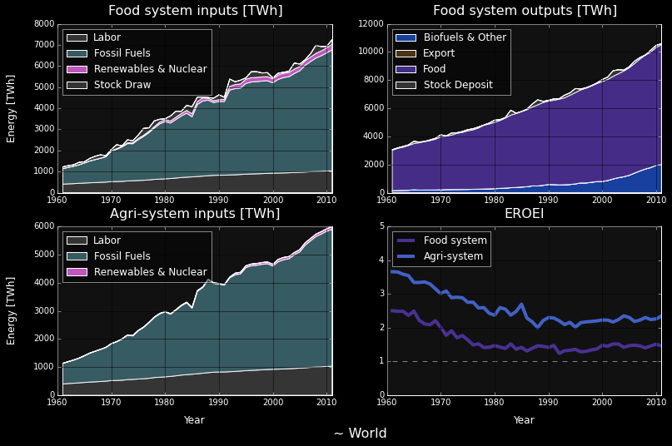
Fossil share 61 % in 1961 79 % in 2011
Agri EROEI 3.66 in 1961 2.35 in 2011
Food EROEI 2.50 in 1961 1.46 in 2011
Sgouridis, Csala (expected 2015)
GRAPH: Own work using open energy and GDP data from World Bank and food balance and trade, labor and fertilizer data from FAOSTAT
Notes:
Wealthy countries could afford to do that because of fossil fuels. 2 problems with that. Depletion and global warming.

Slide 28

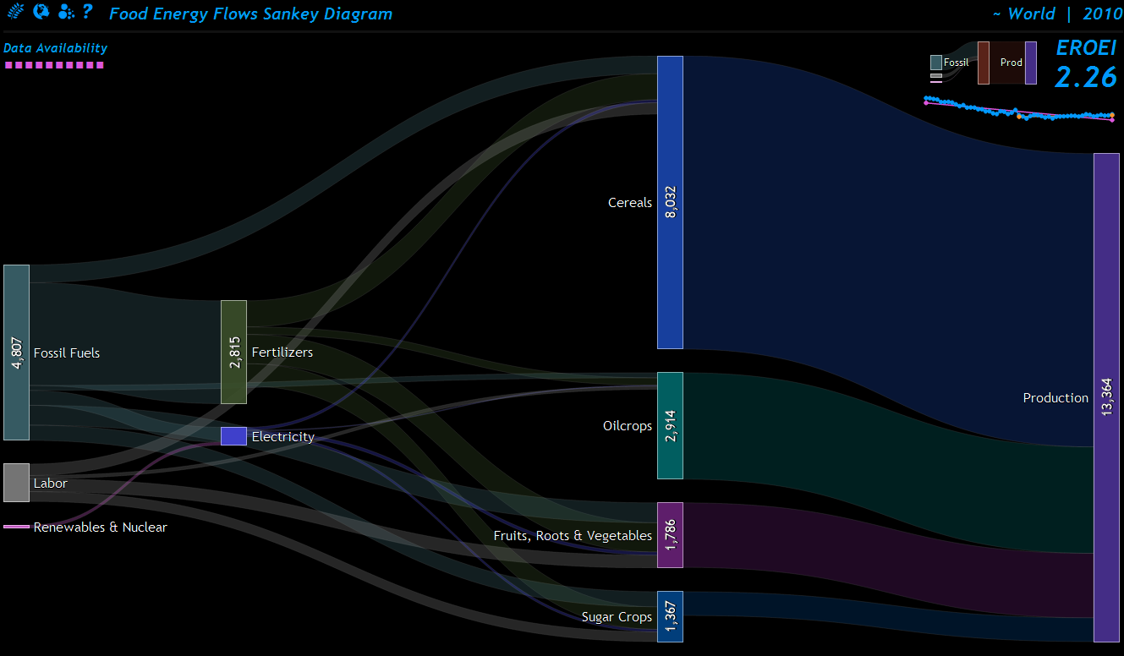
* All values in TWh
Sgouridis, Csala (expected 2015)
GRAPH: Own work using open energy and GDP data from World Bank and food balance and trade, labor and fertilizer data from FAOSTAT
Notes:
Wealthy countries could afford to do that because of fossil fuels. 2 problems with that. Depletion and global warming.

Slide 29
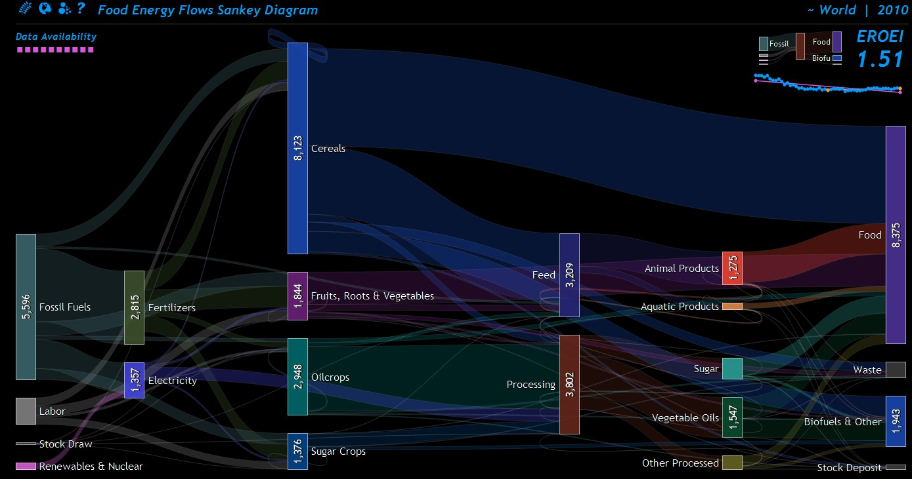
* All values in TWh
Sgouridis, Csala (expected 2015)
GRAPH: Own work using open energy and GDP data from World Bank and food balance and trade, labor and fertilizer data from FAOSTAT
Notes:
Wealthy countries could afford to do that because of fossil fuels. 2 problems with that. Depletion and global warming.

Slide 30
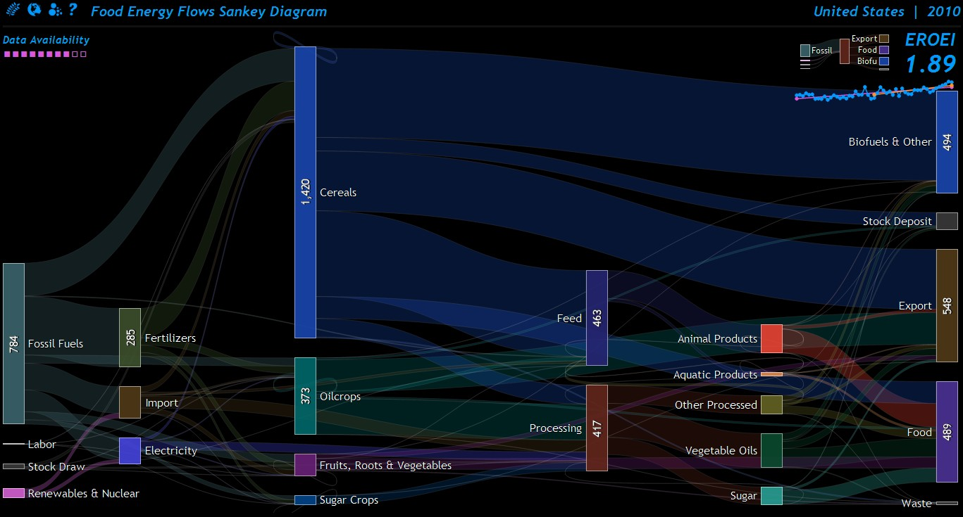
* All values in TWh
Sgouridis, Csala (expected 2015)
GRAPH: Own work using open energy and GDP data from World Bank and food balance and trade, labor and fertilizer data from FAOSTAT
Notes:
Wealthy countries could afford to do that because of fossil fuels. 2 problems with that. Depletion and global warming.

Slide 31
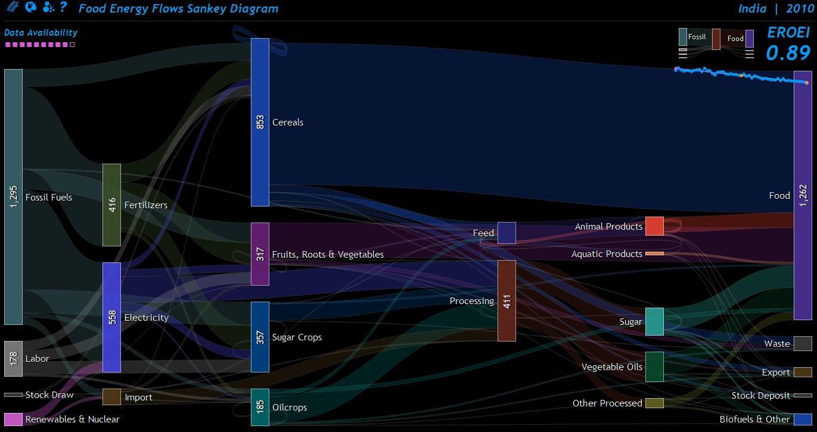
* All values in TWh
Sgouridis, Csala (expected 2015)
GRAPH: Own work using open energy and GDP data from World Bank and food balance and trade, labor and fertilizer data from FAOSTAT
Notes:
Wealthy countries could afford to do that because of fossil fuels. 2 problems with that. Depletion and global warming.

Slide 32
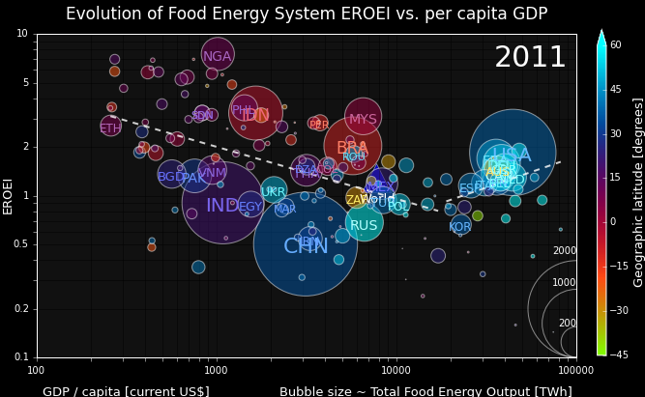
Steady decline of EROEI over time
Correlation with GDP
Recent crop shift obscures the full picture
Not sustainable
Sgouridis, Csala (expected 2015)
GRAPH: Own work using open energy and GDP data from World Bank and food balance and trade, labor and fertilizer data from FAOSTAT
Notes:
Wealthy countries could afford to do that because of fossil fuels. 2 problems with that. Depletion and global warming.

Slide 33
future work

Slide 34
future work
Trade
data
[UN COMTRADE]
Renewable
EROEI
[Literature]
Sustainable Energy Transition Paths
Population projections
[UNSD]
Renewable energy data
Demand data
Demand projections
[Literature]
Modify exiting global model (SET2.0) to include trade flows and terrain limitations
Parse country-pair-energy-flows from UN COMTRADE/MIT OEC
Create import cap mechanism, similar to emissions
IRENA renewable energy potential maps
Create renewable depletion, similar to fossils
Automatically estimate sustainable energy transition paths for nations based on country terrains and trade flows
Conduct per country simulations, analyze and compare to global results
Fossil
data
Emissions data
[IPCC, EIA, BP]

Slide 35
future work
Streamline nexus connections
Investigate the role of biofuels
Summarize and analyze per country food energy data
Decide how to include water data and get/calculate energy from Jesse
Summarize results into major research article
Sustainable Energy Transition Paths
Water-Energy-Food Nexus implications of
Sustainable Energy Transitions
Food energy
flows
Food energy
data
[World Bank]
Food
data
[FAOSTAT]
Water
data
[Jesse]

Slide 36
future work
Modify exiting global model (SET2.0) to include trade flows and terrain limitations
Write algorithm for automatic estimation of sustainable energy transition pathways based on country terrains and trade flows
Conduct per country simulations, analyze and compare to global results
Summarize and analyze per country food energy data
Decide how to include water data and get/calculate energy from Jesse
Investigate of water-energy-food nexus implications
Summarize results into major research article
Write & defend thesis

Slide 37
thank you
Dénes Csala
PhD Qualifying Exam Part 2
Masdar Institute
20 trillion green watts

